Slide 1

Cambond
Your cool brand tagline

Slide 2
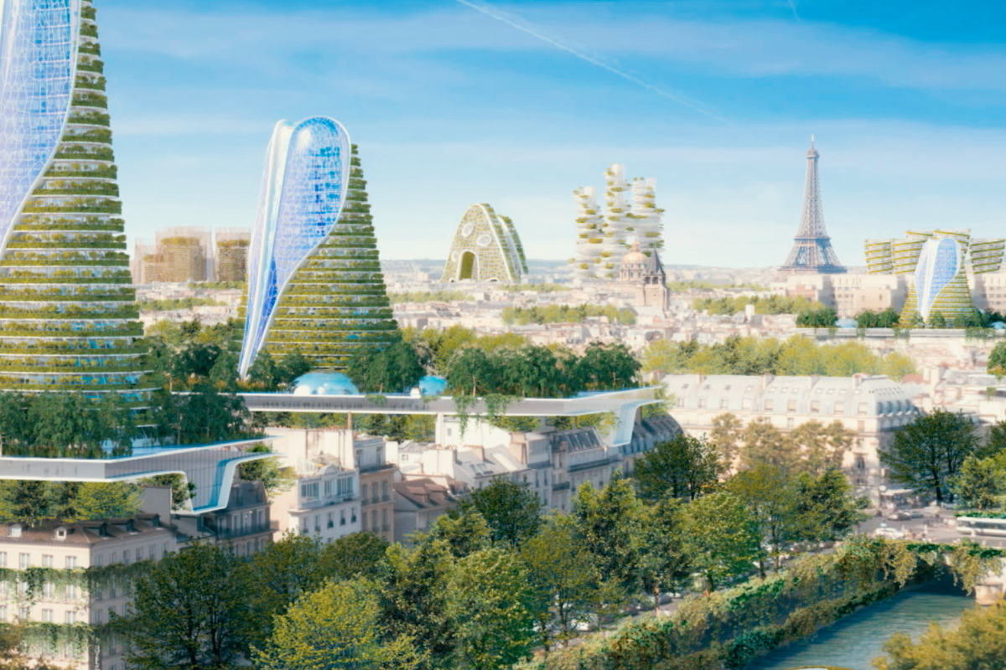
We want to live in an exciting future

Slide 3
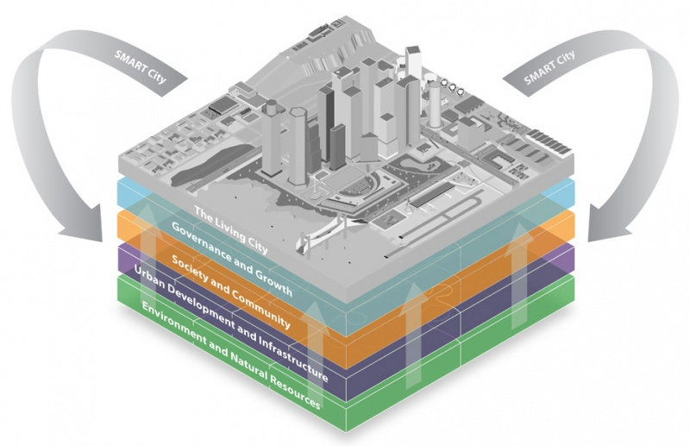
Goal: Smart Sustainable Cities

Slide 4
Constraints
Cost efficiency
Eco-friendliness

Slide 5
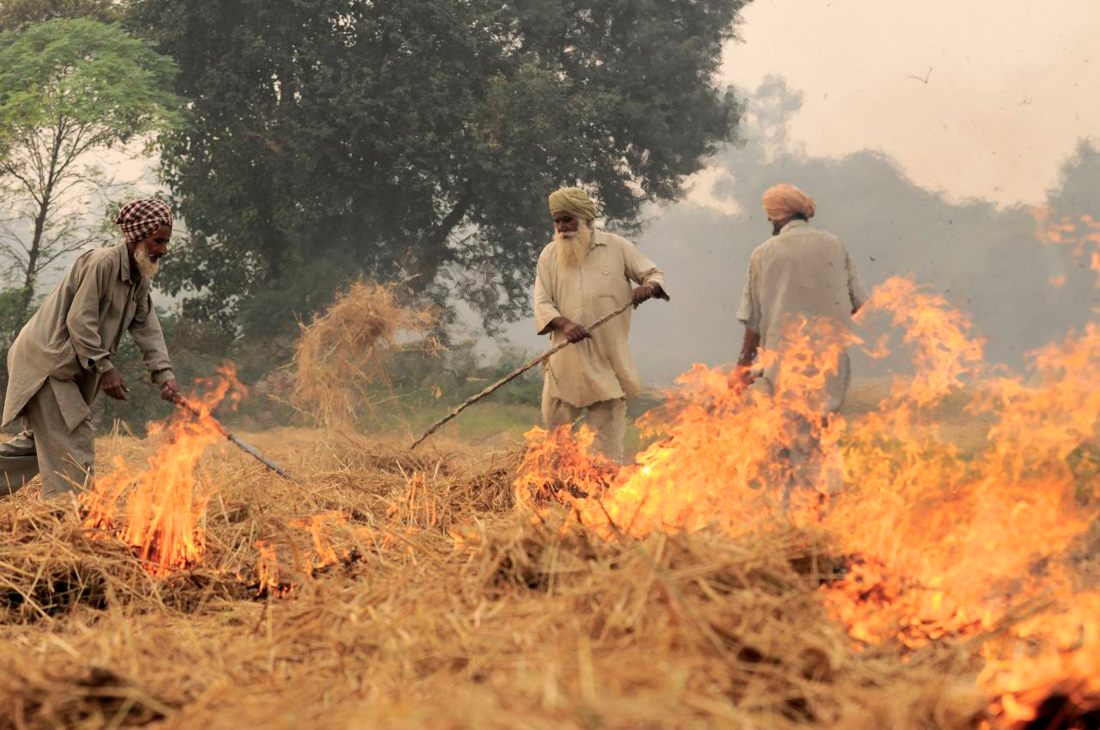
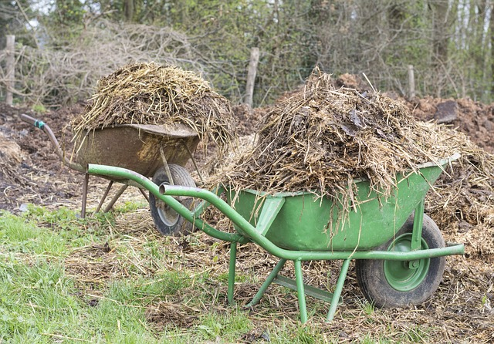
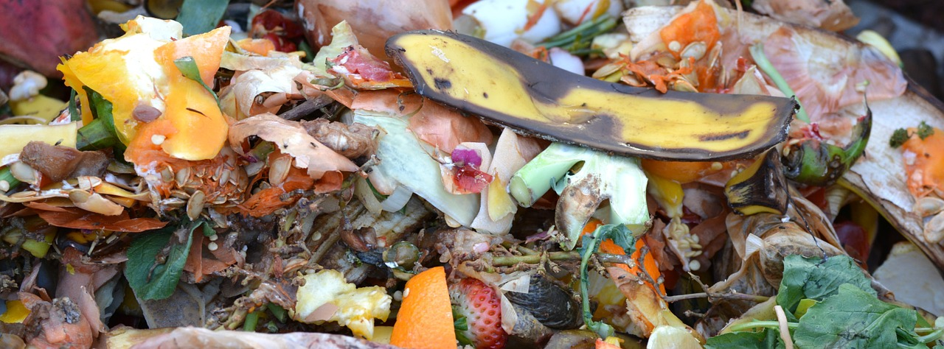
Agriculture produces more than
2 Billion tonnes waste biomass

Slide 6
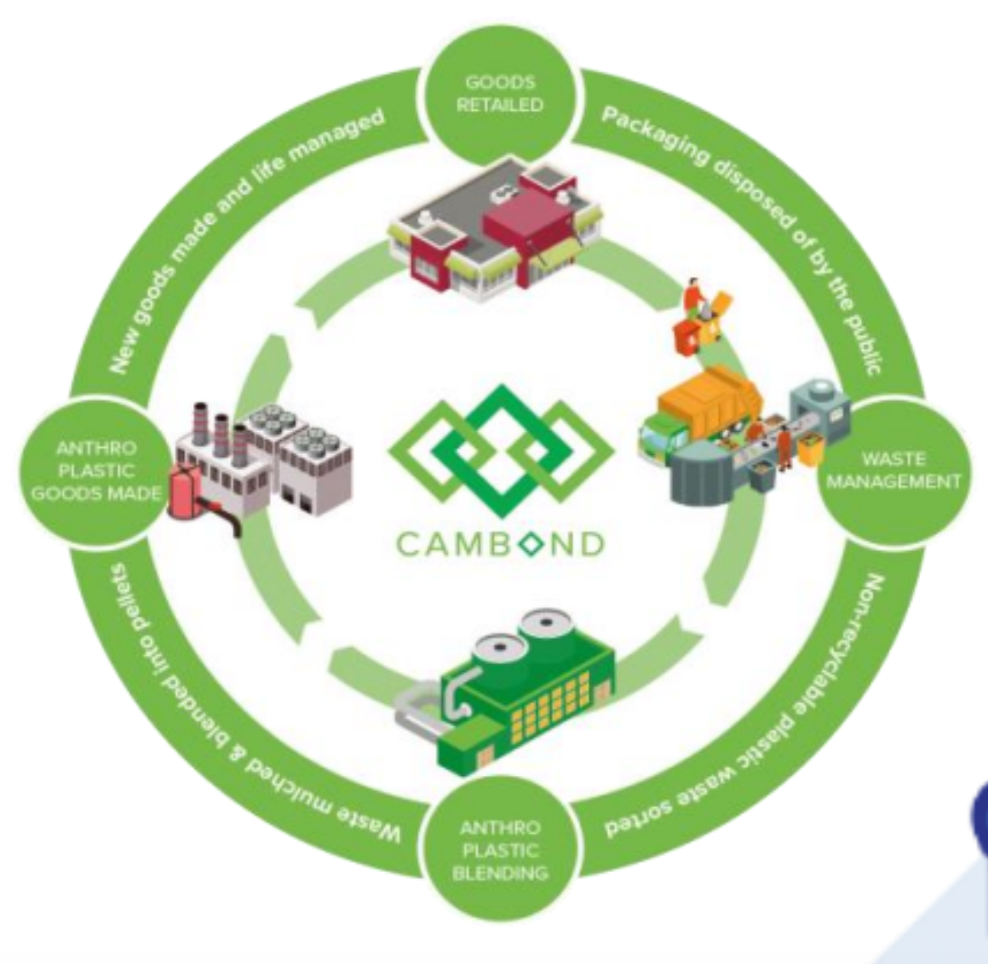
Biomass waste utilisation in low-carbon products:
Cambond Resin

Slide 7
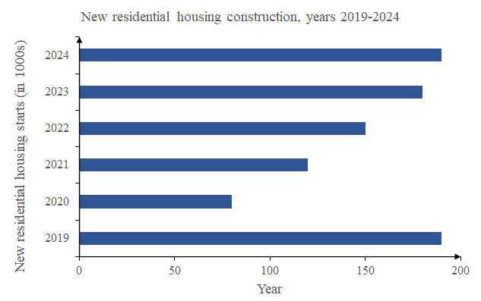
Huge demand for residential housing
Growth of the plasterboard market.

Slide 8
Cambond resin allows to produce a new generation of flat panel boards:
Camboard

Slide 9
Camboard is
Low toxic chemicals
Reduce COST of manufacturing feedstocks
Biodégradable
Lower Carbon footprint (up to 40%)

Slide 10
Awesome features
Awesome map feature
Awesome like feature
Awesome battery feature

Slide 11
Fire resistant boards projected to be the highest in demand
Fire resistant
Class B
Fire resistant boards projected to be the highest in demand

Slide 12
How?
Low temperature firing process
Removes the need for toxic coatings (No need for coatings (curing)) compared to processed wood panels.

Slide 13
Low cost
Low cost (very competitive in price) 3.50 for a 12 mm board compared (class B average for competitors of the same thickness).
PUT PLOT OF PRICES

Slide 14
Rigid boards (innovative bioresin improves the binding strength of the boards).

Slide 15
COMPETION

Slide 16
Mention scalability 🡪 mention impressive partnerships (SAPPI) & manufacturing facilities (capacity)?

Slide 17
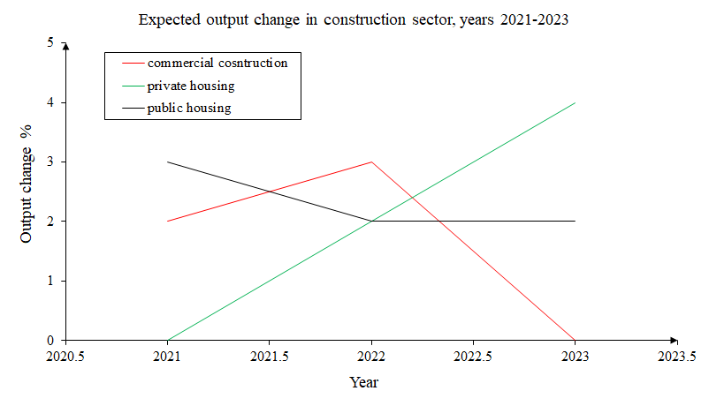
Route MARKET
Sappi Partnership
Business model
Manufacturing
IP

Slide 18
THE TEAM

Slide 19
The Journey

Slide 20
The ASK

Slide 21
Anthropocene mining

Slide 22
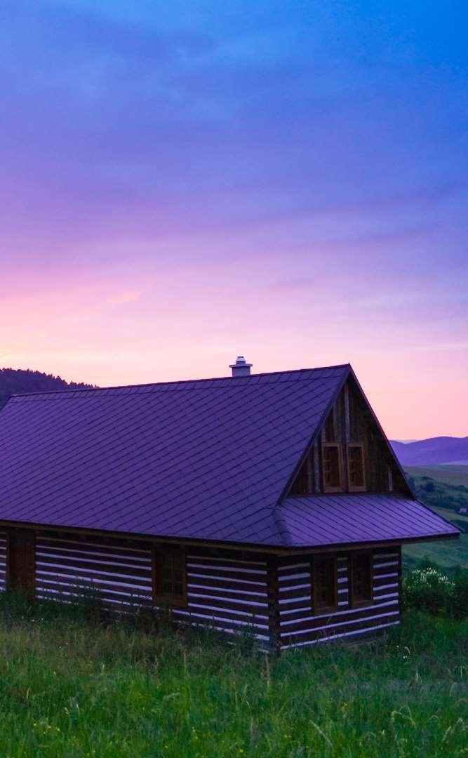
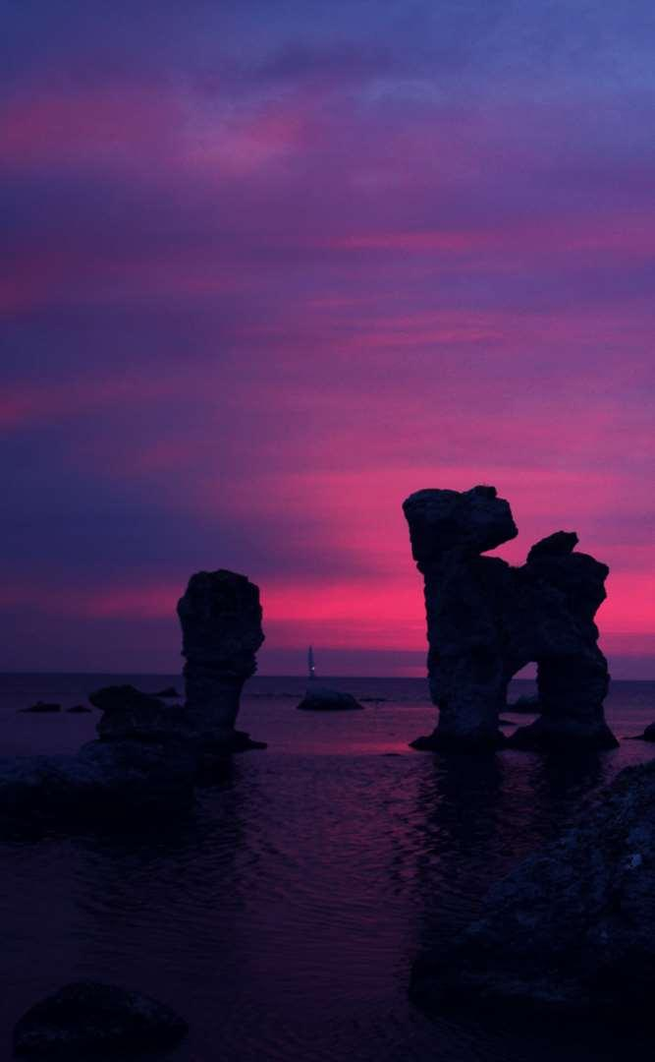

Today’s solutions

Slide 23
Why it doesn’t work
Difficult to implement
Expensive for small businesses
Zero customization

Slide 24
Use case
1
2
3
4
5
Very Easy Step 1
Very Easy Step 2
Very Easy Step 3
Very Easy Step 4
Very Easy Step 5

Slide 25
Value Proposal
Make things really change
Make the world a better place
Offer one perfect answer
This is how we are going to make this happen in a beautiful way.
This is how we are going to make this happen in a beautiful way.
This is how we are going to make this happen in a beautiful way.

Slide 26
Market Sizing
$36b
$12b
$2b
Total World Market
Total US Market
Total FR Market
Source : source.io
Source : source.io
Source : source.io

Slide 27
Market Size over Time
Market Sizing (in €billions)

Slide 28
Market on Map
$1b
$2b

Slide 29
Why Now ?
Mobile Internet Usage

Slide 30


Customer Profiles
Young adults
25-35 years old
Students
15-20 years old

Slide 31
Competitors

Slide 32
AXIS 2
Your company
competitor
competitor
AXIS 1
AXIS 1
competitor
competitor
competitor
competitor
AXIS 2

Slide 33
 | YOUR COMPANY | COMPETITOR 1 | COMPETITOR 2 | COMPETITOR 3
feature 1
feature 2
feature 3
feature 4
feature 5
feature 6

Slide 34
Metrics
800
97%
94%
Paying users
Margin
Recurring users
$150,000
85,000
54
Monthly Recurring
Revenue
Users growing 45% per month
API Integrations

Slide 35
Conversion Rate
0,27%

Slide 36
Split Budget

Slide 37
Split Budget
75%
69%
30%
29%
29%
Marketing
Research
Sales
Design
Hiring

Slide 38
Red
Pink
Purple
Deep Purple
Indigo
Blue
Light Blue
Cyan
Teal
Green
Light Green
Lime
Yellow
Amber
Orange
Deep Orange
50
50
50
50
50
50
50
50
50
50
50
50
50
50
50
50
100
100
100
100
100
100
100
100
100
100
100
100
100
100
100
100
200
200
200
200
200
200
200
200
200
200
200
200
200
200
200
200
300
300
300
300
300
300
300
300
300
300
300
300
300
300
300
300
400
400
400
400
400
400
400
400
400
400
400
400
400
400
400
400
500
500
500
500
500
500
500
500
500
500
500
500
500
500
500
500
600
600
600
600
600
600
600
600
600
600
600
600
600
600
600
600
700
700
700
700
700
700
700
700
700
700
700
700
700
700
700
700
800
800
800
800
800
800
800
800
800
800
800
800
800
800
800
800
900
900
900
900
900
900
900
900
900
900
900
900
900
900
900
900
A100
A100
A100
A100
A100
A100
A100
A100
A100
A100
A100
A100
A100
A100
A100
A100
A200
A200
A200
A200
A200
A200
A200
A200
A200
A200
A200
A200
A200
A200
A200
A200
A400
A400
A400
A400
A400
A400
A400
A400
A400
A400
A400
A400
A400
A400
A400
A400
A700
A700
A700
A700
A700
A700
A700
A700
A700
A700
A700
A700
A700
A700
A700
A700

Slide 39
Gradient 3

